Slide 1



T-SQL: Código de alto desempeño
Eduardo Pivaral (MCSE, MCSA) – Jun 2020

Slide 2





Eduardo Pivaral
Experience
+15 Years of experience working on IT
+10 Years of experience working with SQL Server
Developer of Open Source tools for SQL Server administration, development and productivity.
Certifications
SQL Server Database Consultant @ Pythian
MCSE Data Management and Analytics
MCSA SQL 2016 Database Development
MCSA SQL 2016 Database Administration
MCSA SQL 2012/2014
www.sqlguatemala.com
Eduardo Pivaral
Community
Regular Author for MSSQLTips.com
Regular Author for SQLServerCentral.com
MSSQLTips.com Rookie of the year 2018
Board member of Guatemala SQL Server User Group
Owner of SQLGuatemala.com
@EduardoDBA
Epivaral

Slide 3
AGENDA
Programming mindset
Proper database design
Demos

Slide 4

Database Programming Mindset
…Code for the future!

Slide 5



Long development life cycles - Lead to releases on old systems
New features could improve existing code - STRING_SPLIT(@st, @separator)
Heavy duty by design – concurrent sessions, high volumes of data
Implement data purging/historical movement processes

Slide 6
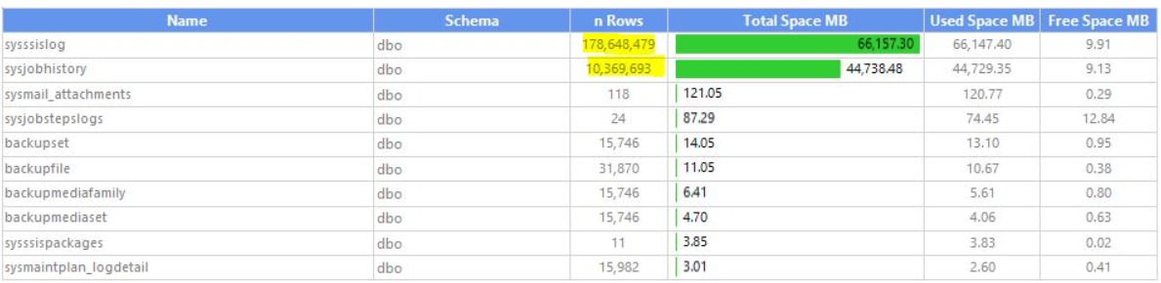
Databases can grow uncontrollably due to message logs and historical data.
http://www.sqlguatemala.com/2017/09/msdb-maintenance-and-cleanup.html

Slide 7
Apply latest patches available on all your development software.
Implement reusable, scalable code – sp_DoSomething(@name);
Comment and format your code: You won’t recognize your own code.
Test your code trying to make it fail.
https://www.sqlguatemala.com/2018/02/considerations-for-dealing-with-big.html

Slide 8

Proper Database Design
Fixing issues before they exists

Slide 9
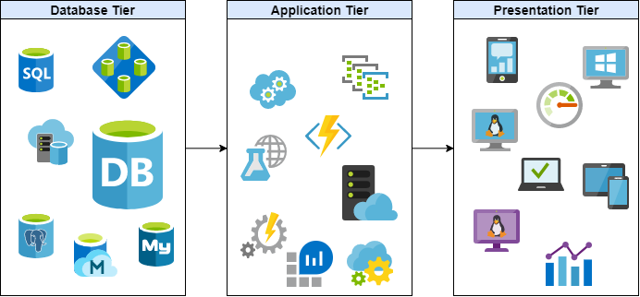
Encapsulate Data operations on database tier
It improves performance and security
Code changes are transparent to application and presentation tier
Minimize Locks by reducing network and IO usage
Migrations are easier without database code on upper tiers

Slide 10
Avoid using SELECT * to send data to client application
By explicitly defining columns, network and disk IO is reduced
Security is improved by sending only required records
ASYNC_NETWORK_IO wait can be avoided
Filter data on the database tier
Data sent to client is reduced even more
SARGABLE: search +‎ argument +‎ -able
Sort data on presentation tier
Sorting is a resource-intensive operation, can negatively impact performance.

Slide 11
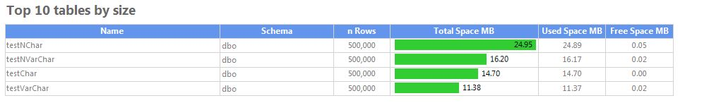
With millions of records, correct datatype make a lot of difference on performance and storage utilization
Wrong datatypes will require data conversions (additional overhead)
Filtering/Joining different datatypes will require implicit conversions (sub-optimal queries)
Comparison between storage used for distinct datatypes storing the exact same data:
Further reading:
https://www.sqlguatemala.com/2018/07/saving-disk-space-by-choosing-correct.html

Slide 12

DEMOS

Slide 13

¡Gracias!
Eduardo Pivaral
@EduardoDBA
Epivaral
www.SQLGuatemala.com
Material disponible en:
https://github.com/Epivaral/Sessions

